Slide 1

FITNESS
12.07.2020 | FINAL PROJECT | MAT-602 APPLIED MACHINE LEARNING |
Mariah Bastos

Slide 2

Agenda
Introduction
1
Assignment 1
2
Assignment 2
3
Extra Model
5
Naive Bayes
6
Association Rules or Clustering
7
Non-Linear Regression
8
Conclusion

Slide 3

DEPENDENT VARIABLE :
WEIGHT_KG
Notes:
1- WHICH KPIS, HOW DO WE CONNECT THE DATABASE, HOW MANY DATABASES WE HAVE?
2- TRAFFIC, REVENUE, SALES?
3- WEEKLY, MONTHLY?
4- ERP SYSTEMS, GOOGLE ANALYTICS, ONLINE SYSTEMS?
5- AFTER TWO WEEKS, 1 MONTH?
6- POWER BI, TABLEAU, EXCEL?

Slide 4
ASSIGNMENT 1

Slide 5
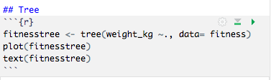
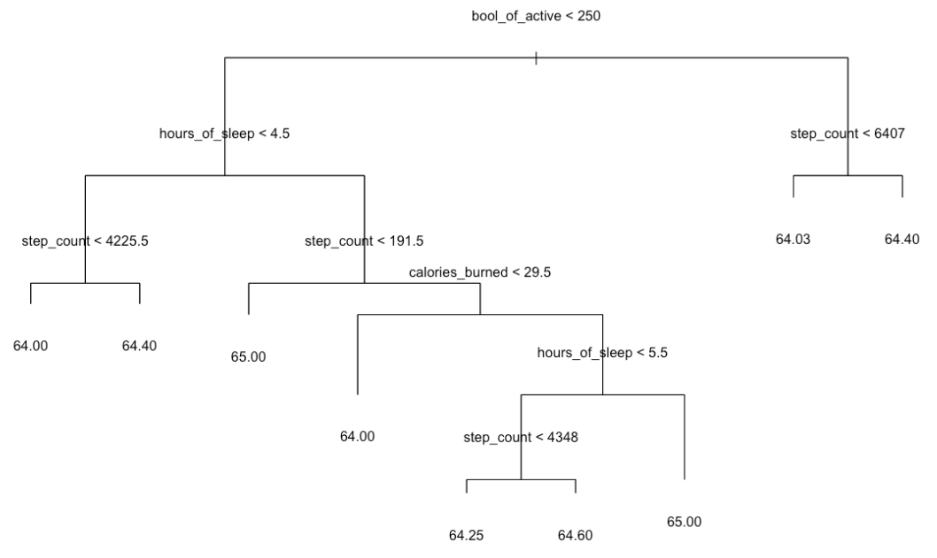
Tree Plot
The tree plot shows that the most important factor to determine weight_kg is to see if the bool_of_active is higher or lower than 250. Then the next most important factors are hours of sleep lower than 4.5 and step_count lower than 6407.
Notes:
1- WHICH KPIS, HOW DO WE CONNECT THE DATABASE, HOW MANY DATABASES WE HAVE?
2- TRAFFIC, REVENUE, SALES?
3- WEEKLY, MONTHLY?
4- ERP SYSTEMS, GOOGLE ANALYTICS, ONLINE SYSTEMS?
5- AFTER TWO WEEKS, 1 MONTH?
6- POWER BI, TABLEAU, EXCEL?

Slide 6
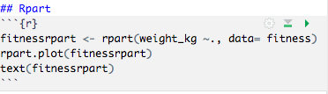
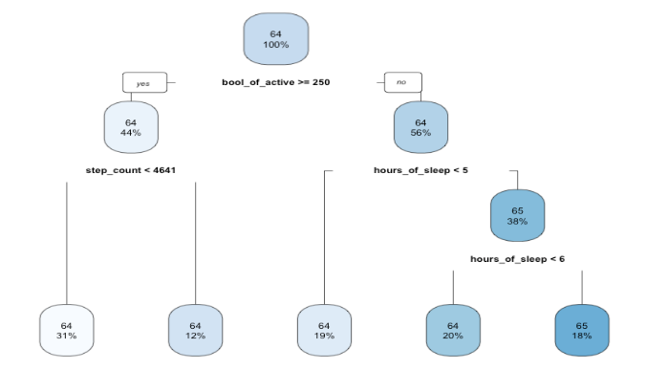
Rpart
The Rpart plot shows that the most important is bool_of_active being bigger or equal to 250, then the next most important factors are step_count being lower than 4641 and hours_of_sleep being lower than 4.5.
Notes:
1- WHICH KPIS, HOW DO WE CONNECT THE DATABASE, HOW MANY DATABASES WE HAVE?
2- TRAFFIC, REVENUE, SALES?
3- WEEKLY, MONTHLY?
4- ERP SYSTEMS, GOOGLE ANALYTICS, ONLINE SYSTEMS?
5- AFTER TWO WEEKS, 1 MONTH?
6- POWER BI, TABLEAU, EXCEL?

Slide 7
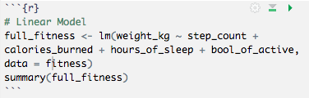
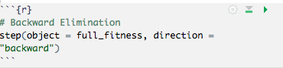
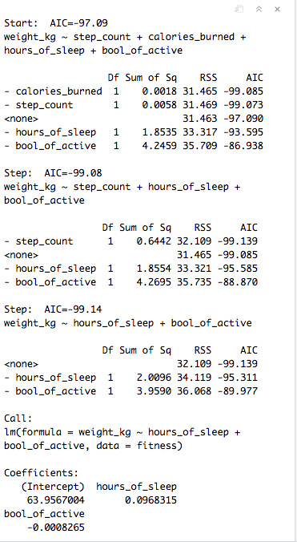
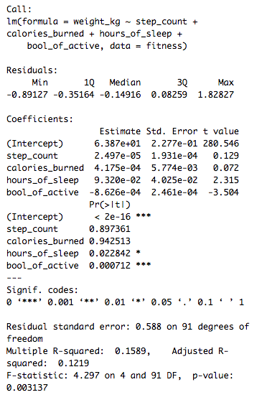
Backward Elimination Approach
Notes:
1- WHICH KPIS, HOW DO WE CONNECT THE DATABASE, HOW MANY DATABASES WE HAVE?
2- TRAFFIC, REVENUE, SALES?
3- WEEKLY, MONTHLY?
4- ERP SYSTEMS, GOOGLE ANALYTICS, ONLINE SYSTEMS?
5- AFTER TWO WEEKS, 1 MONTH?
6- POWER BI, TABLEAU, EXCEL?

Slide 8
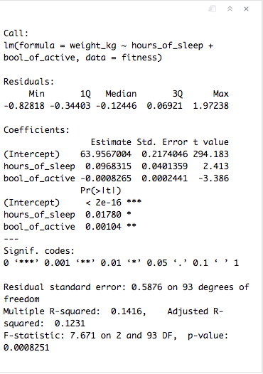
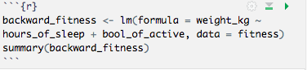
Backward Elimination Approach
Notes:
1- WHICH KPIS, HOW DO WE CONNECT THE DATABASE, HOW MANY DATABASES WE HAVE?
2- TRAFFIC, REVENUE, SALES?
3- WEEKLY, MONTHLY?
4- ERP SYSTEMS, GOOGLE ANALYTICS, ONLINE SYSTEMS?
5- AFTER TWO WEEKS, 1 MONTH?
6- POWER BI, TABLEAU, EXCEL?

Slide 9
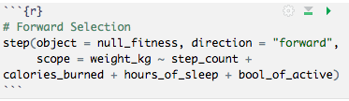
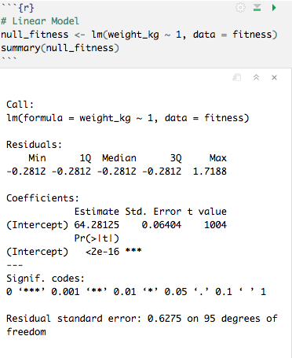
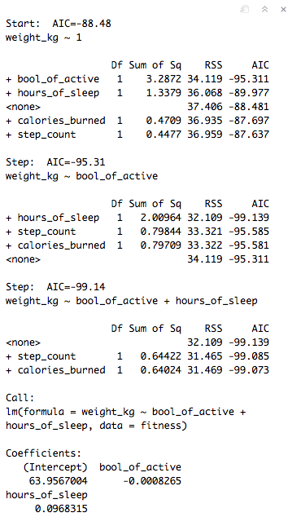
Forward Selection Approach
Notes:
1- WHICH KPIS, HOW DO WE CONNECT THE DATABASE, HOW MANY DATABASES WE HAVE?
2- TRAFFIC, REVENUE, SALES?
3- WEEKLY, MONTHLY?
4- ERP SYSTEMS, GOOGLE ANALYTICS, ONLINE SYSTEMS?
5- AFTER TWO WEEKS, 1 MONTH?
6- POWER BI, TABLEAU, EXCEL?

Slide 10
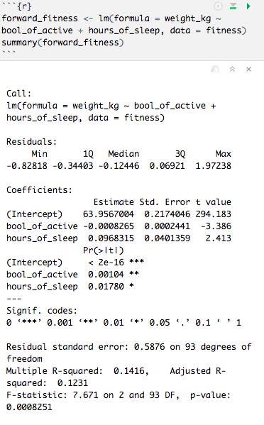
Forward Selection Approach
Notes:
1- WHICH KPIS, HOW DO WE CONNECT THE DATABASE, HOW MANY DATABASES WE HAVE?
2- TRAFFIC, REVENUE, SALES?
3- WEEKLY, MONTHLY?
4- ERP SYSTEMS, GOOGLE ANALYTICS, ONLINE SYSTEMS?
5- AFTER TWO WEEKS, 1 MONTH?
6- POWER BI, TABLEAU, EXCEL?

Slide 11
Conclusion
1
The tree function main variables are: bool_of_active, hours_of_sleep and step_count.
When comparing the four approaches we can notice that bool_of_active and hours_of_sleep are in all four approaches, step_count is in two of them and calories_burned is none.
2
The rpart function main variables are: bool_of_active, step_count and hours_of_sleep.
FITNESS
5
3
Backward elimination main variables are:hours_of_sleep and bool_of_active.
4
Forward selection main variables are: bool_of_active and hours_of_sleep.
Notes:
1- WHICH KPIS, HOW DO WE CONNECT THE DATABASE, HOW MANY DATABASES WE HAVE?
2- TRAFFIC, REVENUE, SALES?
3- WEEKLY, MONTHLY?
4- ERP SYSTEMS, GOOGLE ANALYTICS, ONLINE SYSTEMS?
5- AFTER TWO WEEKS, 1 MONTH?
6- POWER BI, TABLEAU, EXCEL?

Slide 12
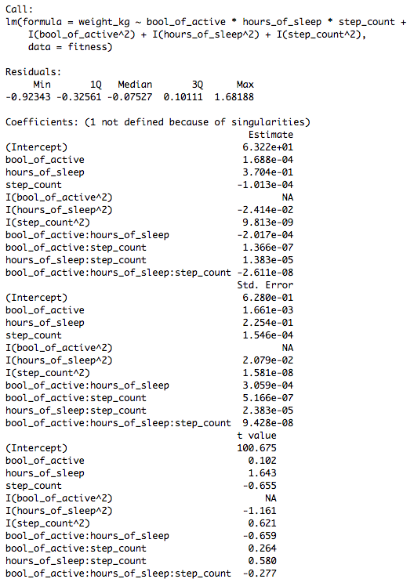
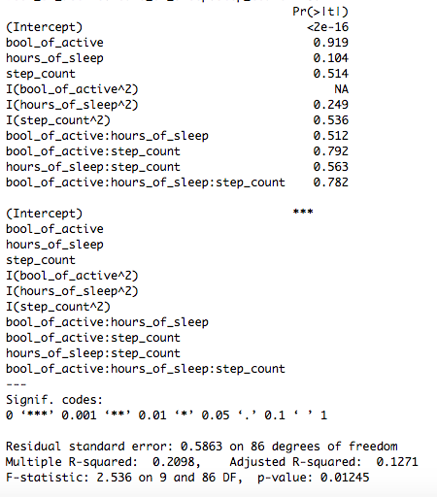
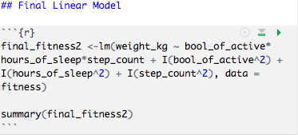
Regression Model
I used the two variables that appeared in all four approaches ( bool_of_active and hours_of_sleep) and the one that appeared in two of them (step_count).
Notes:
1- WHICH KPIS, HOW DO WE CONNECT THE DATABASE, HOW MANY DATABASES WE HAVE?
2- TRAFFIC, REVENUE, SALES?
3- WEEKLY, MONTHLY?
4- ERP SYSTEMS, GOOGLE ANALYTICS, ONLINE SYSTEMS?
5- AFTER TWO WEEKS, 1 MONTH?
6- POWER BI, TABLEAU, EXCEL?

Slide 13
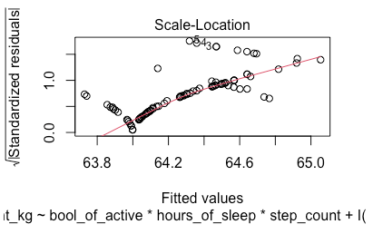
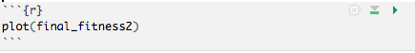
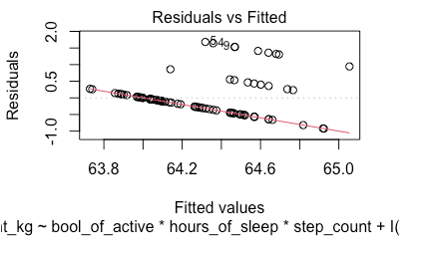
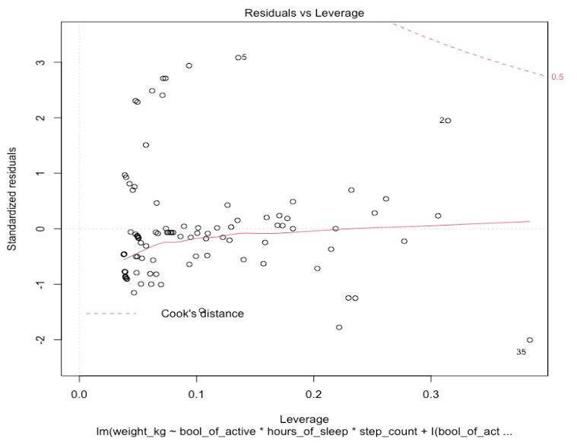
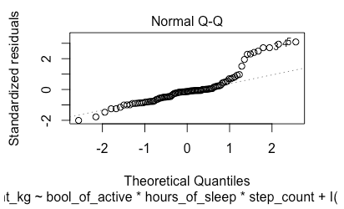
Regression Model
Notes:
1- WHICH KPIS, HOW DO WE CONNECT THE DATABASE, HOW MANY DATABASES WE HAVE?
2- TRAFFIC, REVENUE, SALES?
3- WEEKLY, MONTHLY?
4- ERP SYSTEMS, GOOGLE ANALYTICS, ONLINE SYSTEMS?
5- AFTER TWO WEEKS, 1 MONTH?
6- POWER BI, TABLEAU, EXCEL?

Slide 14
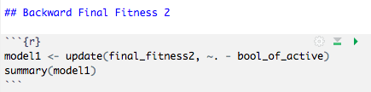
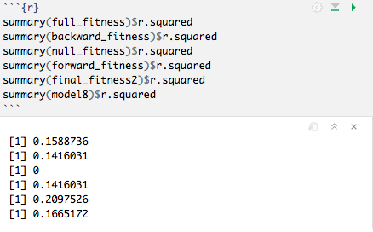
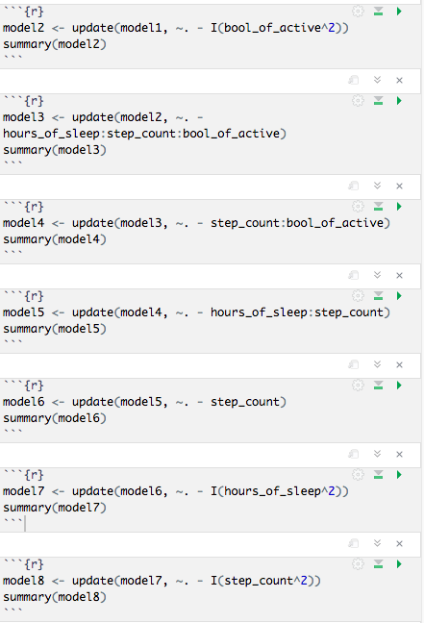
Regression Model
The R squared of the initial model (final_fitness2) is 0.2097526 which is bigger than the R squared of the final model (model8) that is 0.1665172
Notes:
1- WHICH KPIS, HOW DO WE CONNECT THE DATABASE, HOW MANY DATABASES WE HAVE?
2- TRAFFIC, REVENUE, SALES?
3- WEEKLY, MONTHLY?
4- ERP SYSTEMS, GOOGLE ANALYTICS, ONLINE SYSTEMS?
5- AFTER TWO WEEKS, 1 MONTH?
6- POWER BI, TABLEAU, EXCEL?

Slide 15
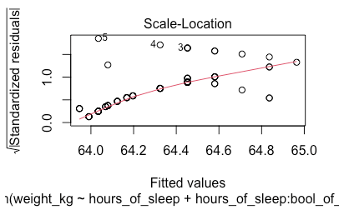
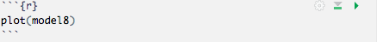
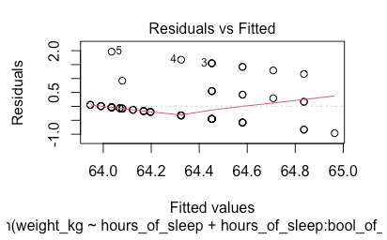
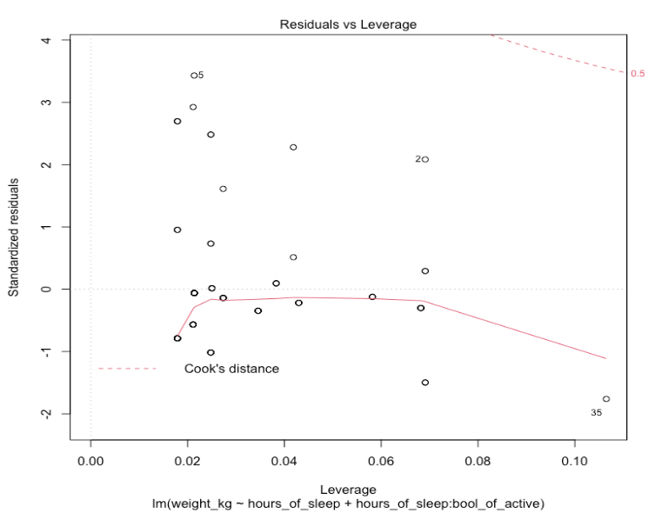
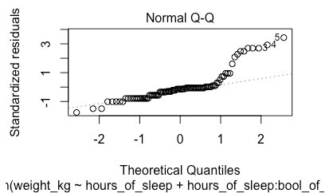
Regression Model Plot
Notes:
1- WHICH KPIS, HOW DO WE CONNECT THE DATABASE, HOW MANY DATABASES WE HAVE?
2- TRAFFIC, REVENUE, SALES?
3- WEEKLY, MONTHLY?
4- ERP SYSTEMS, GOOGLE ANALYTICS, ONLINE SYSTEMS?
5- AFTER TWO WEEKS, 1 MONTH?
6- POWER BI, TABLEAU, EXCEL?

Slide 16
Analysis of the Plots
1
In the residuals vs fitted plot, the line shows the relationship between the fitted values and the residuals.
2
The Normal Q-Q plots shows a concern since the residuals deviate severy from the line at the end, so it shows us a potential problem.
The residuals vs leverage graph show us if there are any influential cases. In this case we can barely see the Cook's distance lines because all cases are inside those lines.
FITNESS REGRESSION MODEL PLOTS
5
3
The scale-location plot shows the relationship of the fitted values against the square root of the abs standardized residuals.
4
the line goes up which shows that the variance increases as the weight in kg increases and the majority of the residuals concentrate on the line but there are still many out of the line.
Notes:
1- WHICH KPIS, HOW DO WE CONNECT THE DATABASE, HOW MANY DATABASES WE HAVE?
2- TRAFFIC, REVENUE, SALES?
3- WEEKLY, MONTHLY?
4- ERP SYSTEMS, GOOGLE ANALYTICS, ONLINE SYSTEMS?
5- AFTER TWO WEEKS, 1 MONTH?
6- POWER BI, TABLEAU, EXCEL?

Slide 17
ASSIGNMENT 2

Slide 18
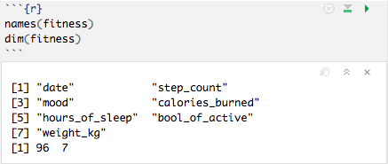
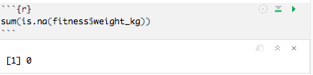
Best Subset Selection
I wanted to see if I was missing any information about the weight_kg in the dataset.
I got the results being equal to 0 which means I am not missing any observations.
Notes:
1- WHICH KPIS, HOW DO WE CONNECT THE DATABASE, HOW MANY DATABASES WE HAVE?
2- TRAFFIC, REVENUE, SALES?
3- WEEKLY, MONTHLY?
4- ERP SYSTEMS, GOOGLE ANALYTICS, ONLINE SYSTEMS?
5- AFTER TWO WEEKS, 1 MONTH?
6- POWER BI, TABLEAU, EXCEL?

Slide 19
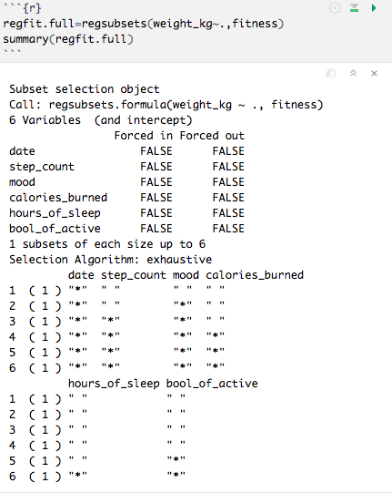
Best Subset Selection
The regsubtets() function identify the best model that contains a given number of predictors where best is quantified using RSS.
The summary gives the best set of variables for each model size. The asterisk shows that the variable is included in the corresponding model. It shows that the best two-variable model have only date and mood.
Notes:
1- WHICH KPIS, HOW DO WE CONNECT THE DATABASE, HOW MANY DATABASES WE HAVE?
2- TRAFFIC, REVENUE, SALES?
3- WEEKLY, MONTHLY?
4- ERP SYSTEMS, GOOGLE ANALYTICS, ONLINE SYSTEMS?
5- AFTER TWO WEEKS, 1 MONTH?
6- POWER BI, TABLEAU, EXCEL?

Slide 20
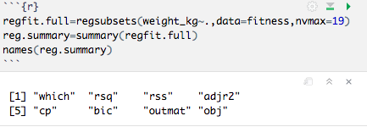
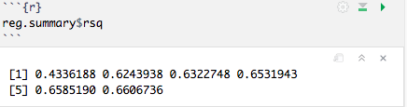
Best Subset Selection
The nvmax is used to return as many variables as desired. We can see that the more variables we have, the R squared increases.
Notes:
1- WHICH KPIS, HOW DO WE CONNECT THE DATABASE, HOW MANY DATABASES WE HAVE?
2- TRAFFIC, REVENUE, SALES?
3- WEEKLY, MONTHLY?
4- ERP SYSTEMS, GOOGLE ANALYTICS, ONLINE SYSTEMS?
5- AFTER TWO WEEKS, 1 MONTH?
6- POWER BI, TABLEAU, EXCEL?

Slide 21
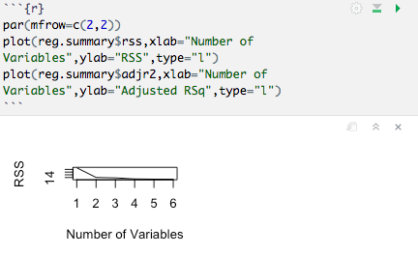
Best Subset Selection
By plotting RSS, adjusted R squared, Cp and BIC for all models at once we can have a better idea on which model to select.
The type= "l" argument tells R to connect the points with lines.
Notes:
1- WHICH KPIS, HOW DO WE CONNECT THE DATABASE, HOW MANY DATABASES WE HAVE?
2- TRAFFIC, REVENUE, SALES?
3- WEEKLY, MONTHLY?
4- ERP SYSTEMS, GOOGLE ANALYTICS, ONLINE SYSTEMS?
5- AFTER TWO WEEKS, 1 MONTH?
6- POWER BI, TABLEAU, EXCEL?

Slide 22
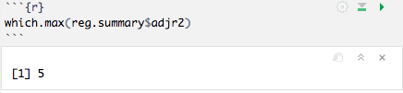
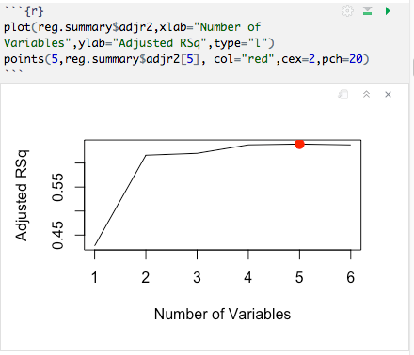
Best Subset Selection
The points function add points to a plot that has been created already. Which.max shows the location of the maximum point of a vector which in this case is on 5.
Notes:
1- WHICH KPIS, HOW DO WE CONNECT THE DATABASE, HOW MANY DATABASES WE HAVE?
2- TRAFFIC, REVENUE, SALES?
3- WEEKLY, MONTHLY?
4- ERP SYSTEMS, GOOGLE ANALYTICS, ONLINE SYSTEMS?
5- AFTER TWO WEEKS, 1 MONTH?
6- POWER BI, TABLEAU, EXCEL?

Slide 23
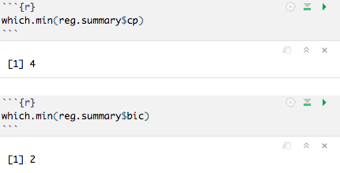
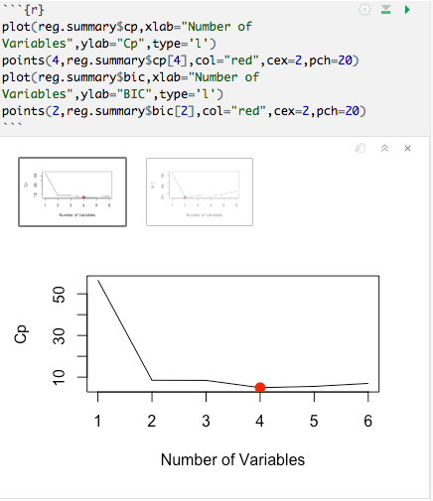
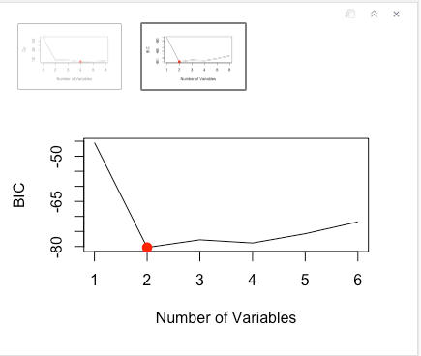
Best Subset Selection
We use which.min to find the models with the smallest statistic.
The regsubsets display the selected variables for the best model.
Notes:
1- WHICH KPIS, HOW DO WE CONNECT THE DATABASE, HOW MANY DATABASES WE HAVE?
2- TRAFFIC, REVENUE, SALES?
3- WEEKLY, MONTHLY?
4- ERP SYSTEMS, GOOGLE ANALYTICS, ONLINE SYSTEMS?
5- AFTER TWO WEEKS, 1 MONTH?
6- POWER BI, TABLEAU, EXCEL?

Slide 24
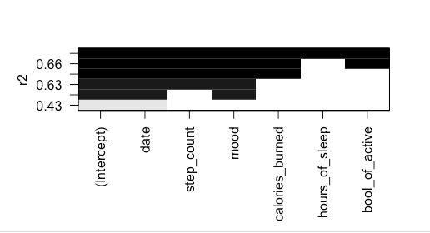
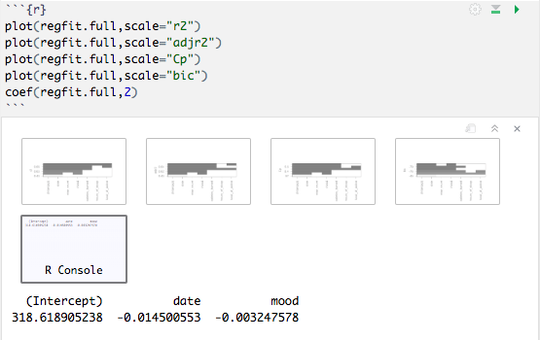
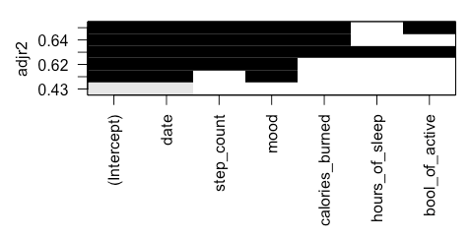
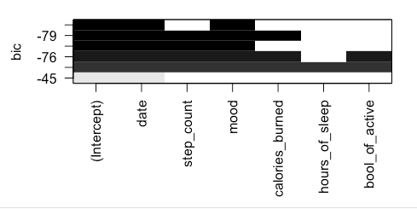
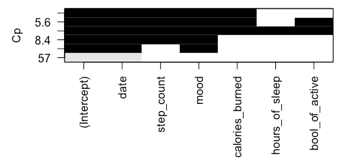
Best Subset Selection
Notes:
1- WHICH KPIS, HOW DO WE CONNECT THE DATABASE, HOW MANY DATABASES WE HAVE?
2- TRAFFIC, REVENUE, SALES?
3- WEEKLY, MONTHLY?
4- ERP SYSTEMS, GOOGLE ANALYTICS, ONLINE SYSTEMS?
5- AFTER TWO WEEKS, 1 MONTH?
6- POWER BI, TABLEAU, EXCEL?

Slide 25
Best Subset Selection
The points function add points to a plot that has been created already. Which.max shows the location of the maximum point of a vector which in this case is on 5.
Notes:
1- WHICH KPIS, HOW DO WE CONNECT THE DATABASE, HOW MANY DATABASES WE HAVE?
2- TRAFFIC, REVENUE, SALES?
3- WEEKLY, MONTHLY?
4- ERP SYSTEMS, GOOGLE ANALYTICS, ONLINE SYSTEMS?
5- AFTER TWO WEEKS, 1 MONTH?
6- POWER BI, TABLEAU, EXCEL?

Slide 26
Best Subset Selection
The points function add points to a plot that has been created already. Which.max shows the location of the maximum point of a vector which in this case is on 5.
Notes:
1- WHICH KPIS, HOW DO WE CONNECT THE DATABASE, HOW MANY DATABASES WE HAVE?
2- TRAFFIC, REVENUE, SALES?
3- WEEKLY, MONTHLY?
4- ERP SYSTEMS, GOOGLE ANALYTICS, ONLINE SYSTEMS?
5- AFTER TWO WEEKS, 1 MONTH?
6- POWER BI, TABLEAU, EXCEL?

Slide 27
Best Subset Selection
The points function add points to a plot that has been created already. Which.max shows the location of the maximum point of a vector which in this case is on 5.
Notes:
1- WHICH KPIS, HOW DO WE CONNECT THE DATABASE, HOW MANY DATABASES WE HAVE?
2- TRAFFIC, REVENUE, SALES?
3- WEEKLY, MONTHLY?
4- ERP SYSTEMS, GOOGLE ANALYTICS, ONLINE SYSTEMS?
5- AFTER TWO WEEKS, 1 MONTH?
6- POWER BI, TABLEAU, EXCEL?

Slide 28
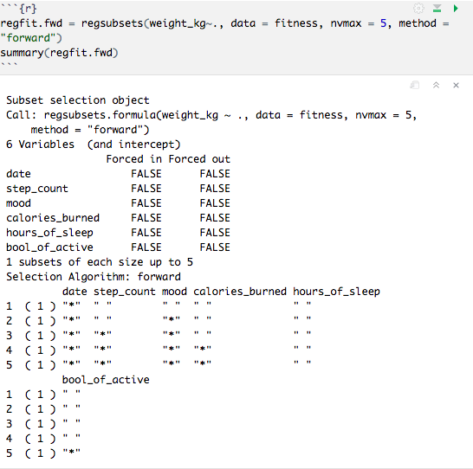
Forward Stepwise Selection
The forward model shows that the date and mood are the most significant variables.
Notes:
1- WHICH KPIS, HOW DO WE CONNECT THE DATABASE, HOW MANY DATABASES WE HAVE?
2- TRAFFIC, REVENUE, SALES?
3- WEEKLY, MONTHLY?
4- ERP SYSTEMS, GOOGLE ANALYTICS, ONLINE SYSTEMS?
5- AFTER TWO WEEKS, 1 MONTH?
6- POWER BI, TABLEAU, EXCEL?

Slide 29
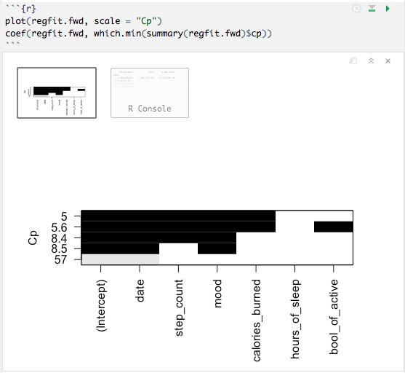
Forward Stepwise Selection
The forward model shows that the date and mood are the most significant variables.
Notes:
1- WHICH KPIS, HOW DO WE CONNECT THE DATABASE, HOW MANY DATABASES WE HAVE?
2- TRAFFIC, REVENUE, SALES?
3- WEEKLY, MONTHLY?
4- ERP SYSTEMS, GOOGLE ANALYTICS, ONLINE SYSTEMS?
5- AFTER TWO WEEKS, 1 MONTH?
6- POWER BI, TABLEAU, EXCEL?

Slide 30
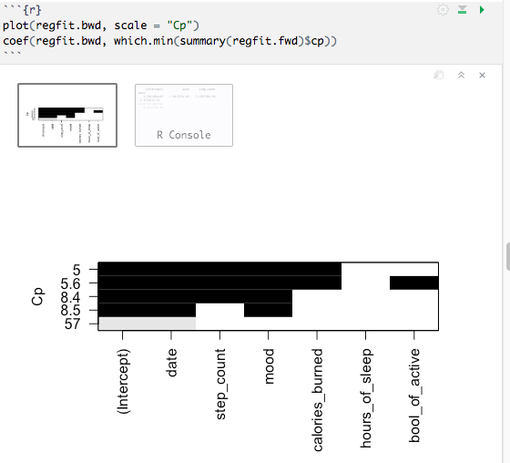
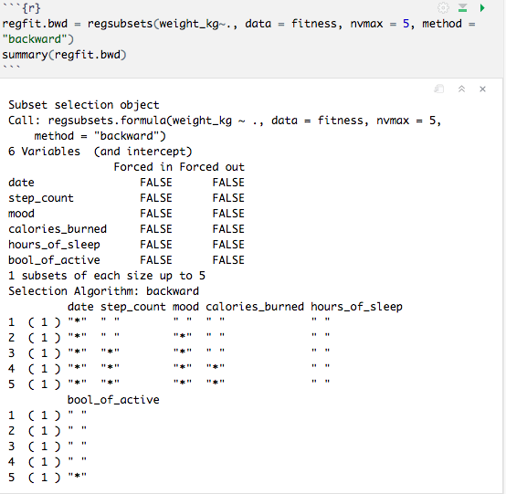
Backward Stepwise Selection
The backward model shows that the date and mood are the most significant variables.
Notes:
1- WHICH KPIS, HOW DO WE CONNECT THE DATABASE, HOW MANY DATABASES WE HAVE?
2- TRAFFIC, REVENUE, SALES?
3- WEEKLY, MONTHLY?
4- ERP SYSTEMS, GOOGLE ANALYTICS, ONLINE SYSTEMS?
5- AFTER TWO WEEKS, 1 MONTH?
6- POWER BI, TABLEAU, EXCEL?

Slide 31


Resampling Methods 10- Fold Cross Validation
Notes:
1- WHICH KPIS, HOW DO WE CONNECT THE DATABASE, HOW MANY DATABASES WE HAVE?
2- TRAFFIC, REVENUE, SALES?
3- WEEKLY, MONTHLY?
4- ERP SYSTEMS, GOOGLE ANALYTICS, ONLINE SYSTEMS?
5- AFTER TWO WEEKS, 1 MONTH?
6- POWER BI, TABLEAU, EXCEL?

Slide 32


Cross Validation
Notes:
1- WHICH KPIS, HOW DO WE CONNECT THE DATABASE, HOW MANY DATABASES WE HAVE?
2- TRAFFIC, REVENUE, SALES?
3- WEEKLY, MONTHLY?
4- ERP SYSTEMS, GOOGLE ANALYTICS, ONLINE SYSTEMS?
5- AFTER TWO WEEKS, 1 MONTH?
6- POWER BI, TABLEAU, EXCEL?

Slide 33


Resampling Methods - Cross Validation
Notes:
1- WHICH KPIS, HOW DO WE CONNECT THE DATABASE, HOW MANY DATABASES WE HAVE?
2- TRAFFIC, REVENUE, SALES?
3- WEEKLY, MONTHLY?
4- ERP SYSTEMS, GOOGLE ANALYTICS, ONLINE SYSTEMS?
5- AFTER TWO WEEKS, 1 MONTH?
6- POWER BI, TABLEAU, EXCEL?

Slide 34


Cross Validation
Notes:
1- WHICH KPIS, HOW DO WE CONNECT THE DATABASE, HOW MANY DATABASES WE HAVE?
2- TRAFFIC, REVENUE, SALES?
3- WEEKLY, MONTHLY?
4- ERP SYSTEMS, GOOGLE ANALYTICS, ONLINE SYSTEMS?
5- AFTER TWO WEEKS, 1 MONTH?
6- POWER BI, TABLEAU, EXCEL?

Slide 35
EXTRA MODEL:
Polynomial Regression

Slide 36

Polynomial Regression
The syntax fits a linear model by using the lm function to predict weight_kg using a fourth- degree polynomial in hours_of_sleep: poly(hours_of_sleep, 4). The function results in a matrix whose columns are a basis of orthogonal polynomials which means that every column in a linear combination of hours_of_sleep, hours_of_sleep^2, hours_of_sleep^3 and hours_of_sleep^4.
Notes:
1- WHICH KPIS, HOW DO WE CONNECT THE DATABASE, HOW MANY DATABASES WE HAVE?
2- TRAFFIC, REVENUE, SALES?
3- WEEKLY, MONTHLY?
4- ERP SYSTEMS, GOOGLE ANALYTICS, ONLINE SYSTEMS?
5- AFTER TWO WEEKS, 1 MONTH?
6- POWER BI, TABLEAU, EXCEL?

Slide 37

Polynomial Regression
Here I used raw=TRUE to use poly to obtain hours_of_sleep, hours_of_sleep^2, hours_of_sleep^3 and hours_of_sleep^4 directly. But i will show later that it does not significantly affect the model.
Notes:
1- WHICH KPIS, HOW DO WE CONNECT THE DATABASE, HOW MANY DATABASES WE HAVE?
2- TRAFFIC, REVENUE, SALES?
3- WEEKLY, MONTHLY?
4- ERP SYSTEMS, GOOGLE ANALYTICS, ONLINE SYSTEMS?
5- AFTER TWO WEEKS, 1 MONTH?
6- POWER BI, TABLEAU, EXCEL?

Slide 38

Polynomial Regression
Here I created a grid of values for hours_of_sleep at which I want the predictions and I uses predict to obtain the standard errors as well.
Notes:
1- WHICH KPIS, HOW DO WE CONNECT THE DATABASE, HOW MANY DATABASES WE HAVE?
2- TRAFFIC, REVENUE, SALES?
3- WEEKLY, MONTHLY?
4- ERP SYSTEMS, GOOGLE ANALYTICS, ONLINE SYSTEMS?
5- AFTER TWO WEEKS, 1 MONTH?
6- POWER BI, TABLEAU, EXCEL?

Slide 39

Polynomial Regression
Plotted the data and added the fit from the degree-4 polynomial. mar and oma arguments to par function allows me to control the margins of the plot.
Notes:
1- WHICH KPIS, HOW DO WE CONNECT THE DATABASE, HOW MANY DATABASES WE HAVE?
2- TRAFFIC, REVENUE, SALES?
3- WEEKLY, MONTHLY?
4- ERP SYSTEMS, GOOGLE ANALYTICS, ONLINE SYSTEMS?
5- AFTER TWO WEEKS, 1 MONTH?
6- POWER BI, TABLEAU, EXCEL?

Slide 40

Polynomial Regression
I used the anova function to perform an analysis of variance in order to test the null hypothesis. I fit all five different models and compare the simpler model to the more complex model. Model 4 gives us the biggest p-value.
Notes:
1- WHICH KPIS, HOW DO WE CONNECT THE DATABASE, HOW MANY DATABASES WE HAVE?
2- TRAFFIC, REVENUE, SALES?
3- WEEKLY, MONTHLY?
4- ERP SYSTEMS, GOOGLE ANALYTICS, ONLINE SYSTEMS?
5- AFTER TWO WEEKS, 1 MONTH?
6- POWER BI, TABLEAU, EXCEL?

Slide 41

Polynomial Regression
P- values are the same, and the square of the t-statistics are equal to the f-statistics from the anova function.
Notes:
1- WHICH KPIS, HOW DO WE CONNECT THE DATABASE, HOW MANY DATABASES WE HAVE?
2- TRAFFIC, REVENUE, SALES?
3- WEEKLY, MONTHLY?
4- ERP SYSTEMS, GOOGLE ANALYTICS, ONLINE SYSTEMS?
5- AFTER TWO WEEKS, 1 MONTH?
6- POWER BI, TABLEAU, EXCEL?

Slide 42

Polynomial Regression
Anova method works even if I don't use orthogonal polynomials.
Notes:
1- WHICH KPIS, HOW DO WE CONNECT THE DATABASE, HOW MANY DATABASES WE HAVE?
2- TRAFFIC, REVENUE, SALES?
3- WEEKLY, MONTHLY?
4- ERP SYSTEMS, GOOGLE ANALYTICS, ONLINE SYSTEMS?
5- AFTER TWO WEEKS, 1 MONTH?
6- POWER BI, TABLEAU, EXCEL?

Slide 43
Conclusion
1
In the residuals vs fitted plot, the line shows the relationship between the fitted values and the residuals.
2
The Normal Q-Q plots shows a concern since the residuals deviate severy from the line at the end, so it shows us a potential problem.
The residuals vs leverage graph show us if there are any influential cases. In this case we can barely see the Cook's distance lines because all cases are inside those lines.
FITNESS REGRESSION MODEL PLOTS
5
3
The scale-location plot shows the relationship of the fitted vlaues against the square root of the abs standarlized residuals.
4
the line goes up which shows that the variance inscreases as the weight in kg increases and the majority of the residuals concentrate on the line but there are still many out of the line.
Notes:
1- WHICH KPIS, HOW DO WE CONNECT THE DATABASE, HOW MANY DATABASES WE HAVE?
2- TRAFFIC, REVENUE, SALES?
3- WEEKLY, MONTHLY?
4- ERP SYSTEMS, GOOGLE ANALYTICS, ONLINE SYSTEMS?
5- AFTER TWO WEEKS, 1 MONTH?
6- POWER BI, TABLEAU, EXCEL?

Slide 44

Non- Linear Regression
THANK YOU
Mariah Bastos
Notes:
1- WHICH KPIS, HOW DO WE CONNECT THE DATABASE, HOW MANY DATABASES WE HAVE?
2- TRAFFIC, REVENUE, SALES?
3- WEEKLY, MONTHLY?
4- ERP SYSTEMS, GOOGLE ANALYTICS, ONLINE SYSTEMS?
5- AFTER TWO WEEKS, 1 MONTH?
6- POWER BI, TABLEAU, EXCEL?

